Slide 1

Digital Experiences
Data Visualization with Powerbi Tool

Slide 2
Overview
Re-defining the data using data visualization techniques with PowerBi
Key actionable Insights
Identify data trends/patterns
Define predictive trend with historical data
Establish a connection with business outcomes
Drives Decision making process
Implications of Data Visualization/Digital Experience

Slide 3
Sample PowerBi Dashboards

Slide 4
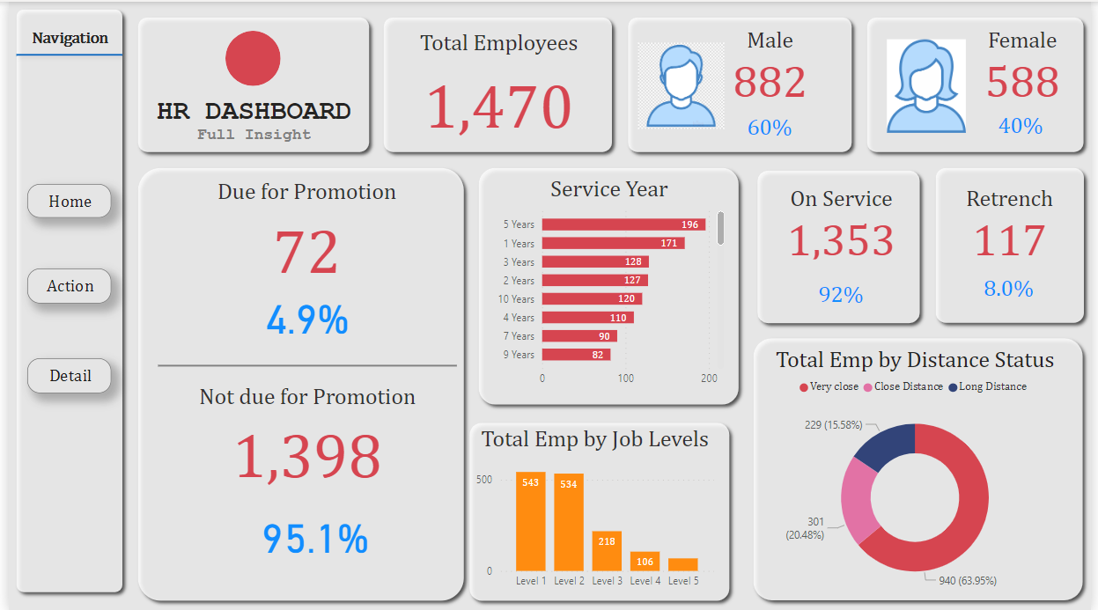

Slide 5
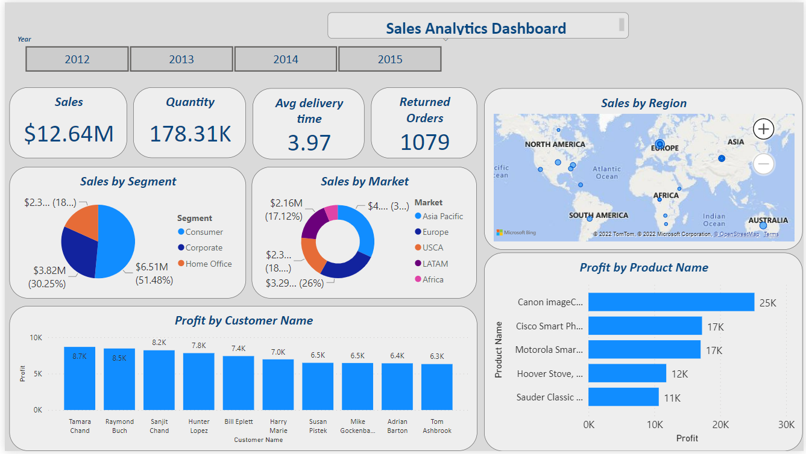

Slide 6
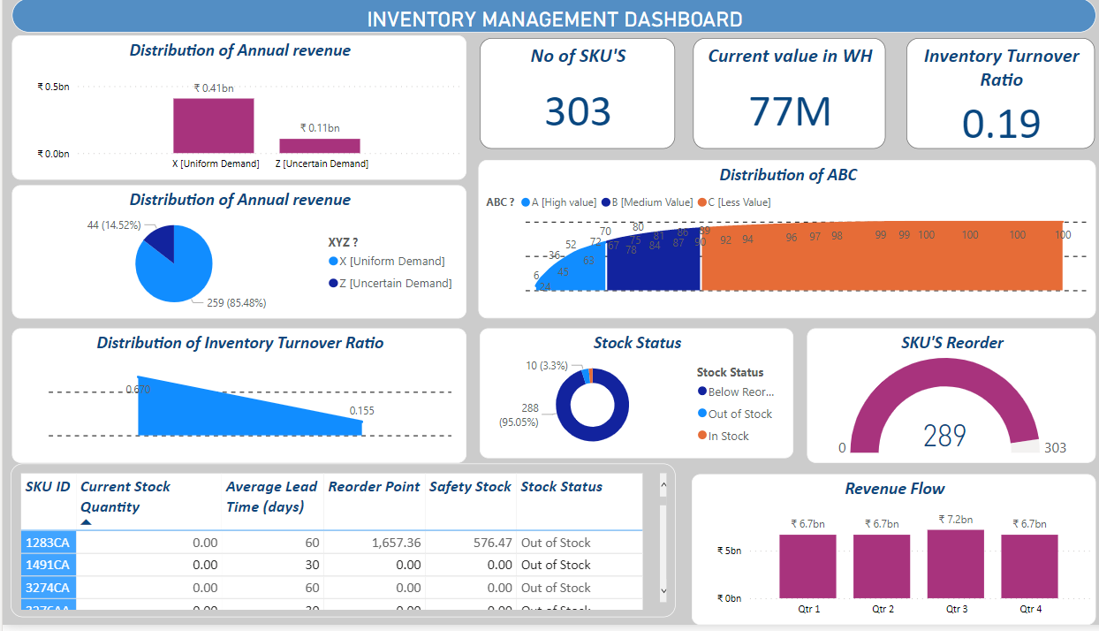

Slide 7
Thank you
*Resources – Dashboards links mentioned below for reference:
1.
2.
3.

